Slide 1
Violent Hate Crime Statistics Research Paper
Presentation

Slide 2
ABSTRACT
In recent years, the global surge in violent hate crimes has raised significant concern. The United States, in particular, has witnessed a notable increase in such incidents.
Against this backdrop, my research project aims to develop a predictive model capable of anticipating violent hate crimes relative to nonviolent hate crimes.

Slide 3
Introduction:
On October 7th, 2023, Hamas, a designated terrorist organization, carried out an infiltration operation into Israeli sovereign territory. The global repercussions of this event are significant, including within the United States, where incidents of violent hate crimes have surged.
Recent data trends reveal a concerning increase in violent hate crime cases, with the 2022 hate crime statistics showing the highest number of reported incidents in recent years.
In response to this alarming trend, my research project aims to develop a predictive model capable of anticipating violent hate crimes relative to nonviolent hate crimes.

Slide 4
Literature Review
Machine Learning and Predictive Policing: A Promising Avenue
While existing research has primarily focused on demographic factors and economic conditions as determinants of hate crimes, the intersection of machine learning and predictive policing offers a promising avenue for enhancing understanding and addressing these offenses.
Temporal Clustering of Hate Crimes (King et al., 2019):
King and colleagues’ study highlights the temporal clustering of hate-motivated offenses. Their hypothesis that many hate crimes are retaliatory in nature provides valuable insights.
Notably, contentious trial verdicts related to interracial crimes precede spikes in racially or religiously motivated hate crimes. Similarly, lethal domestic terrorist attacks lead to increased hate crimes as retaliation.
However, the study also reveals that anti-gay hate crimes do not necessarily follow court rulings that grant rights to same-sex partners. This nuanced understanding challenges the assumption of uniform retaliation.

Slide 5
Literature Review
Predictive Policing: Benefits and Drawbacks (Mugari and Obioha, 2021):
Predictive policing systems have evolved significantly over the last decade, leveraging modern technology to forecast criminal activity.
Various software applications, such as PredPol, Risk Terrain Modelling, and HunchLab, have been implemented globally. However, their effectiveness remains mixed.
Key benefits include the potential for crime prevention, resource allocation optimization, and proactive law enforcement.
Yet, limitations persist, some are:
Algorithm Accuracy: Some predictive algorithms exhibit limited accuracy in forecasting criminal events.
Crime Type Specificity: Not all types of crimes can be effectively predicted using existing models.
Cost and Implementation: Implementing and maintaining predictive systems can be expensive.
Data Quality and Bias: The reliability of predictions depends on data quality, and biases in data or algorithms can lead to discriminatory outcomes.

Slide 6
Literature Review
Machine Learning and Hate Crime Prediction: An Untapped Frontier:
While temporal and geographic predictions have received attention, machine learning’s potential for hate crime prediction remains relatively unexplored.
Geographically restricted studies, such as Jendryke and McClure’s analysis using an artificial neural network, demonstrate the feasibility of prediction even with limited data points.
Policymakers and researchers should consider expanding the scope to include machine learning techniques that account for various features beyond time and location.
The FBI Hate Crime Dataset: A Valuable Resource:
The Federal Bureau of Investigation’s extensive hate crime dataset spanning 1991 to 2022 provides a wealth of information.
Leveraging machine learning algorithms on this dataset could yield valuable insights into hate crime patterns, contributing to evidence-based policy decisions.
In conclusion, integrating machine learning into predictive policing and hate crime prevention efforts holds immense potential. By addressing limitations and leveraging rich datasets, I can enhance the ability to combat hate-motivated offenses effectively.

Slide 7
Methodology
Predictive Modeling for Violent Hate Crimes
Data Collection and Preprocessing:
Data Source: Utilizing data from the FBI crime lab statistics (Table 1), I obtained information on hate crimes.
Data Cleaning: Rigorous cleaning and preprocessing were performed to ensure data quality and consistency.
Quality Assurance: This step is crucial to remove noise, handle missing values, and standardize the dataset.
Exploration of Key Features:
Victim Demographics: I examined features related to victims, such as age, gender, ethnicity, and other relevant demographics.
Incident Location: Understanding where hate crimes occur geographically provides valuable context.
Other Relevant Features: Depending on the available data, I explored additional features that might influence hate crime occurrence.
Feature Extraction and Model Building:
Logistic Regression: I employed logistic regression to model the relationship between features and the likelihood of violent hate crimes.
Random Forest: Random forest models were also constructed to capture complex interactions among features.
Feature Importance: By analyzing feature importance scores, I identified which factors contribute significantly to predicting violent hate crimes

Slide 8
Methodology
Model Evaluation:
Performance Metrics: I evaluated model performance using relevant metrics such as accuracy, precision, recall, and F1-score.
Cross-Validation: To ensure robustness, I used techniques like k-fold cross-validation.
Addressing Limitations:
Data Limitations: Acknowledging any limitations in the dataset, such as biases or missing information.
Generalization: Considering how my model might generalize to real-world scenarios beyond the dataset.
Conclusion: My methodology aims to develop a predictive model that enhances the understanding of violent hate crimes. By rigorously analyzing features and evaluating model performance, I contribute to efforts aimed at preventing and addressing these incidents.

Slide 9
Data Preparation
Data Preparation Steps for Predictive Modeling:
Data Cleaning and Types:
The raw dataset spans from 1991 to 2022 and contains 241,663 data points with sixteen features.
No duplicate data points were present, and data types were appropriately adjusted.
Creating the Response Variable (Violent):
The response variable “violent” was created based on the FBI’s definition of violence using the “offense_name” feature.
All other hate crime offenses were collapsed and re-coded using one-hot encoding to create separate features for each “offense_name.”
Since offenses can co-occur, this approach accounts for incidents with both violent and non-violent aspects, resulting in 399 unique combinations of offense types.
Feature Engineering for Victim Types and Location:
Victim Types:
There are 55 unique victim types in the dataset.
These were collapsed and recoded to create 7 new features, reducing dimensionality.
Location Name:
The “location_name” feature represents where hate crime incidents occurred.
Of the 149 unique location names, 15 new features were created after collapsing and recoding.
Grouping categories broadly helps prevent overfitting.
Broad Categorization Using One-Hot Encoding:
Bias Name:
One-hot encoding was used to broadly categorize “bias_name.”
Population Grouping for Metropolitan Areas:
Population descriptions were condensed into meaningful categories.
The original 8 categories were recoded into 4 to improve statistical po.
Offender Race and Ethnicity:
Offender race was grouped into White, Black, Asian, and Other.
Missing/unknown categories were recoded as NA.
Offender ethnicity was grouped into Latino, Non-Latino, and Other, with missing/unknown recoded as NA.

Slide 10
Data Preparation
Feature Selection:
Features with very low proportions of violent hate crimes (possibly even zero occurrences) were dropped.
A threshold of under 1% occurrences in both violent and non-violent categories was used for feature selection.
Conclusion: Effective data preparation is critical for building reliable predictive models. By transforming and engineering features, I can enhance the ability to predict violent hate crimes accurately.

Slide 11
Data Exploration
Temporal Variation:
Hate crimes often exhibit fluctuations over time due to various contextual factors.
They found that:
Terrorist Attacks: Both print and online news related to terrorism, refugees, and immigration are associated with an increase in nonviolent hate crimes.
Hate Speech Prosecution: News about the hate speech prosecution of a prominent political leader also influenced nonviolent hate crime occurrence.
Speech by Anti-Immigration Actors: Tentative evidence suggested a contagion effect related to anti-immigration actors.
Violent Hate Crime: Only terrorist attacks had a modest effect on violent hate crimes.
Geographic Variation:
Hate crimes are not evenly distributed geographically.
Understanding the spatial distribution of hate crimes can inform targeted interventions and policy decisions.
Contextual Factors:
The interplay of security (terrorism), media (news), and political factors contributes to a climate for hate.
Perceived threats play a key role in shaping hate crime incidence.
In summary, exploring temporal and geographic trends in hate crimes provides valuable insights for prevention and intervention efforts. By analyzing the dataset, I can further investigate these patterns and contribute to a better understanding of hate-motivated offenses.

Slide 12
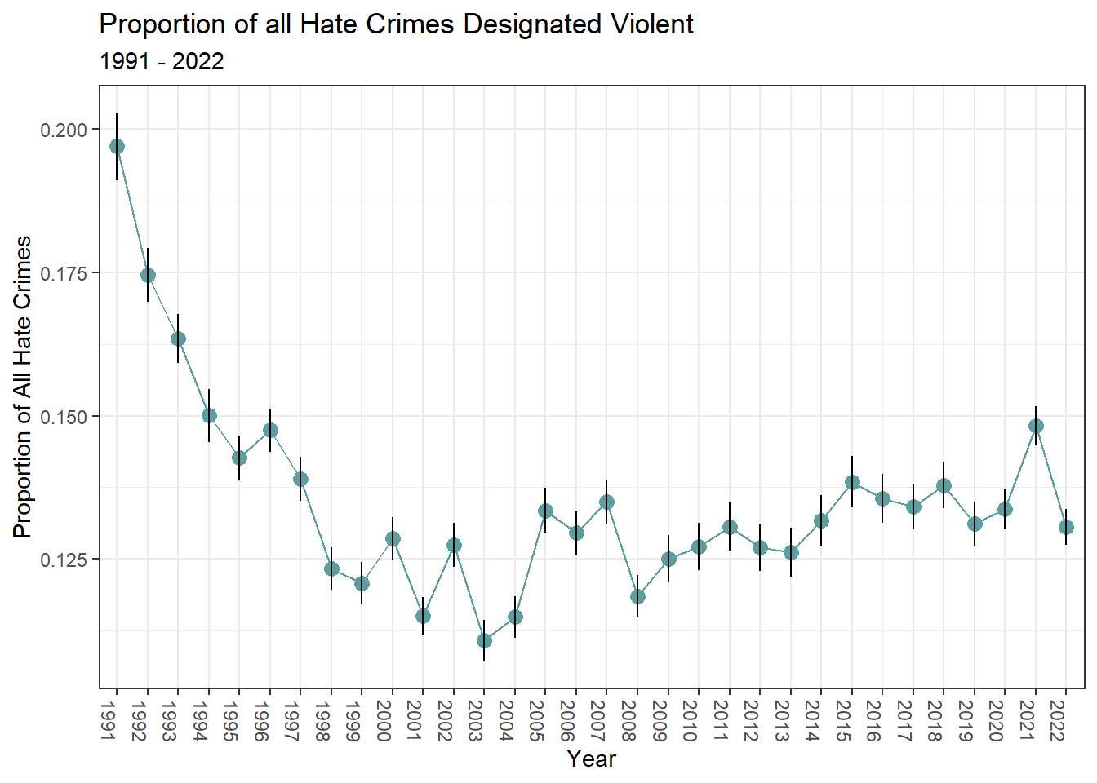
Have violent hate crimes varied by year?
While the historical data indicates a declining trend in violent hate crimes over the past three decades, it is essential to recognize that recent global and domestic events can significantly impact these patterns. For instance, the 10/7 HAMAS attack serves as a stark reminder of the potential for sudden increases in violent hate crimes within the United States.

Slide 13
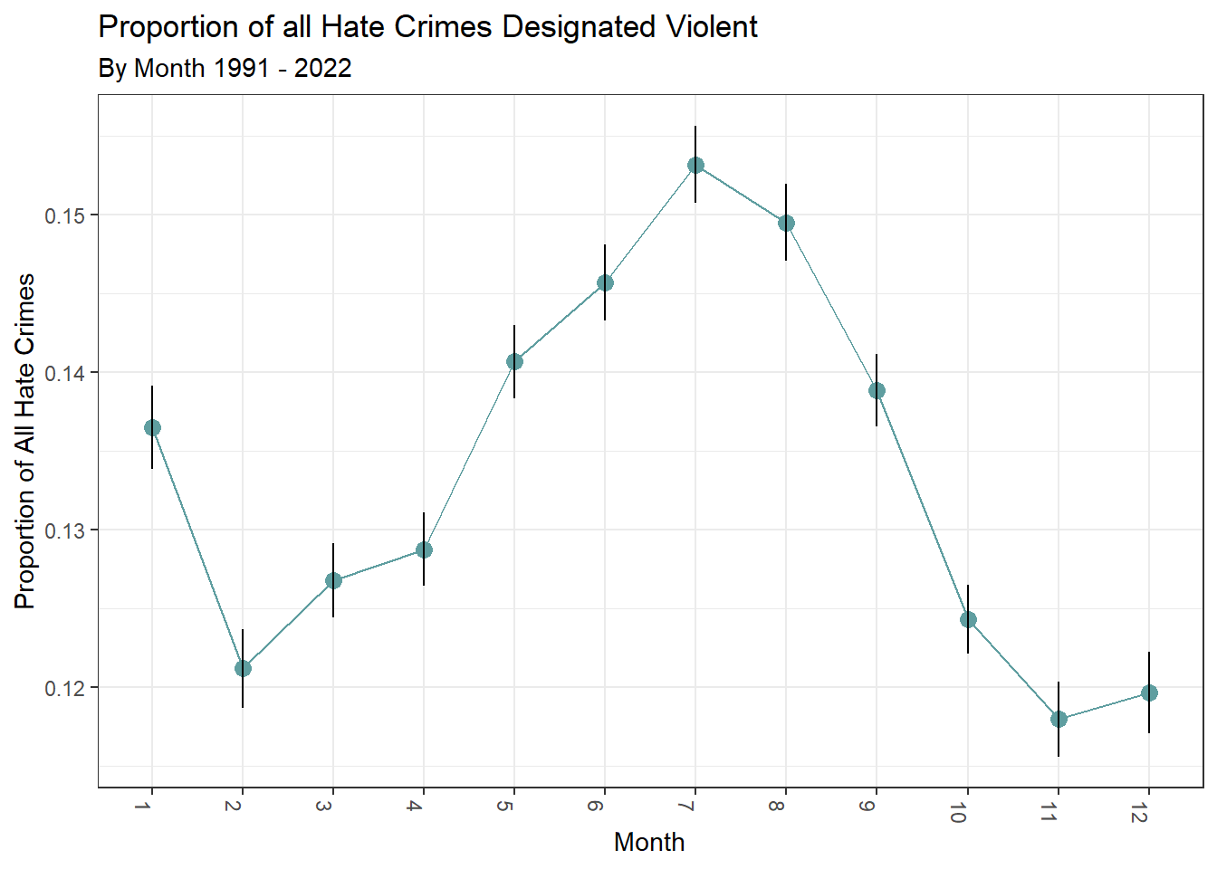
Have violent hate crimes varied by month?
The data reveals a consistent pattern over the past three decades: violent hate crimes tend to occur more frequently during the mid-summer months, with the highest incidence observed in July.

Slide 14
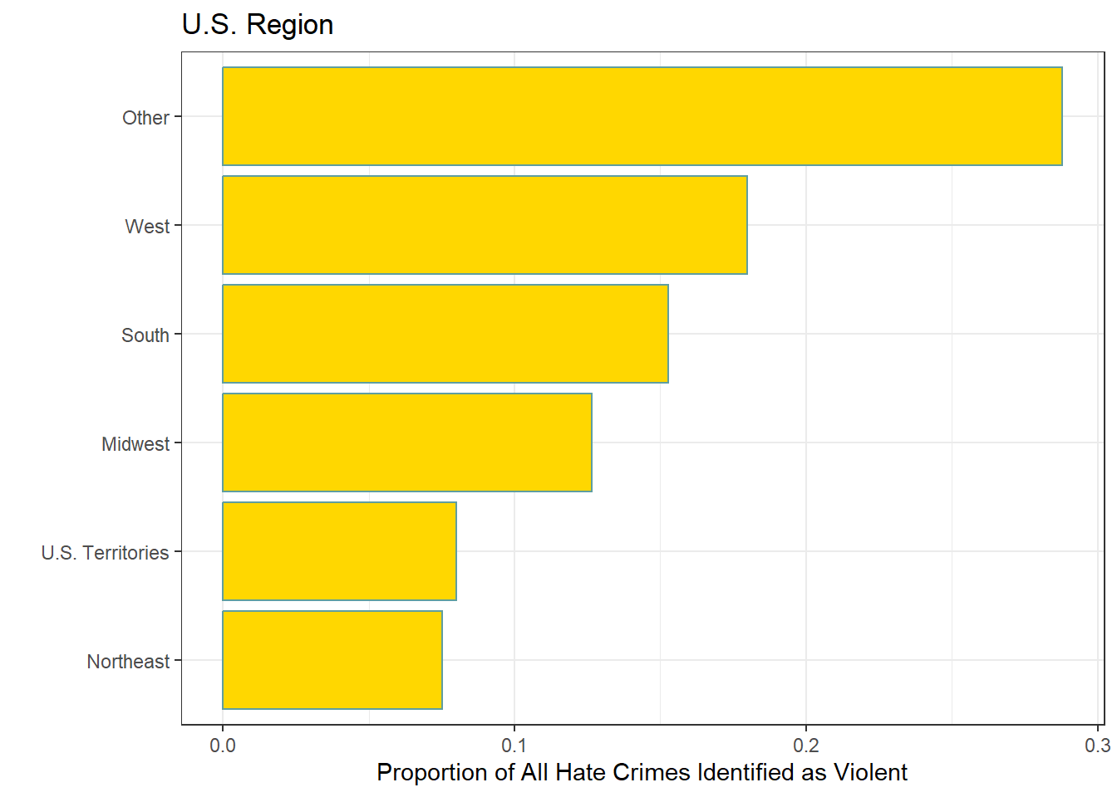
What is the distribution of violent hate crimes by region?
Geographically, violent hate crimes are most frequently reported in the United States within regions classified as ‘other,’ such as US territories and tribal grounds (nearly 30% of all hate crimes). Following closely are the West Coast states. In contrast, the Northeast region has the lowest incidence of violent hate crimes, accounting for less than 10% of the total reported cases in the United States.

Slide 15
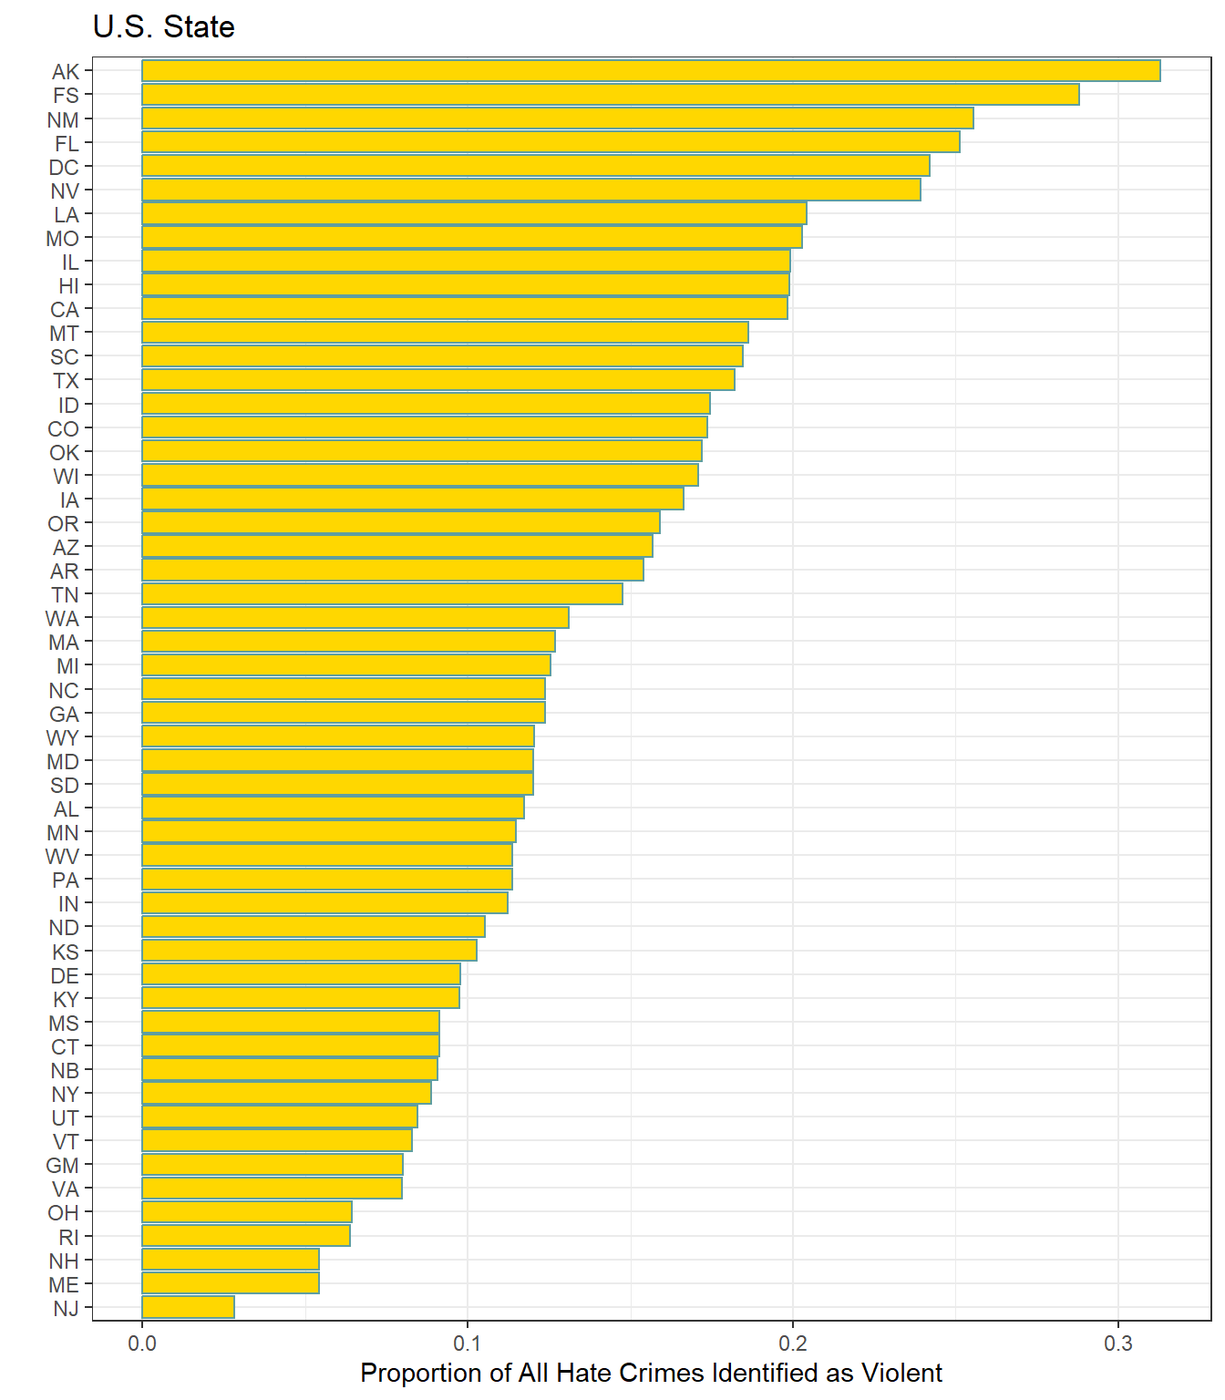
What is the distribution of violent hate crimes by state?
The highest proportion of violent hate crimes by state occurs in Alaska, followed by incidents on foreign soil. This pattern is consistent with the fact that Alaska has the largest Native American tribal areas in the United States. New Jersey has the lowest proportion of violent hate crimes. This aligns with the overall trend, as the Northeast region consistently reports the lowest proportion of violent hate crimes across all U.S. regions

Slide 16
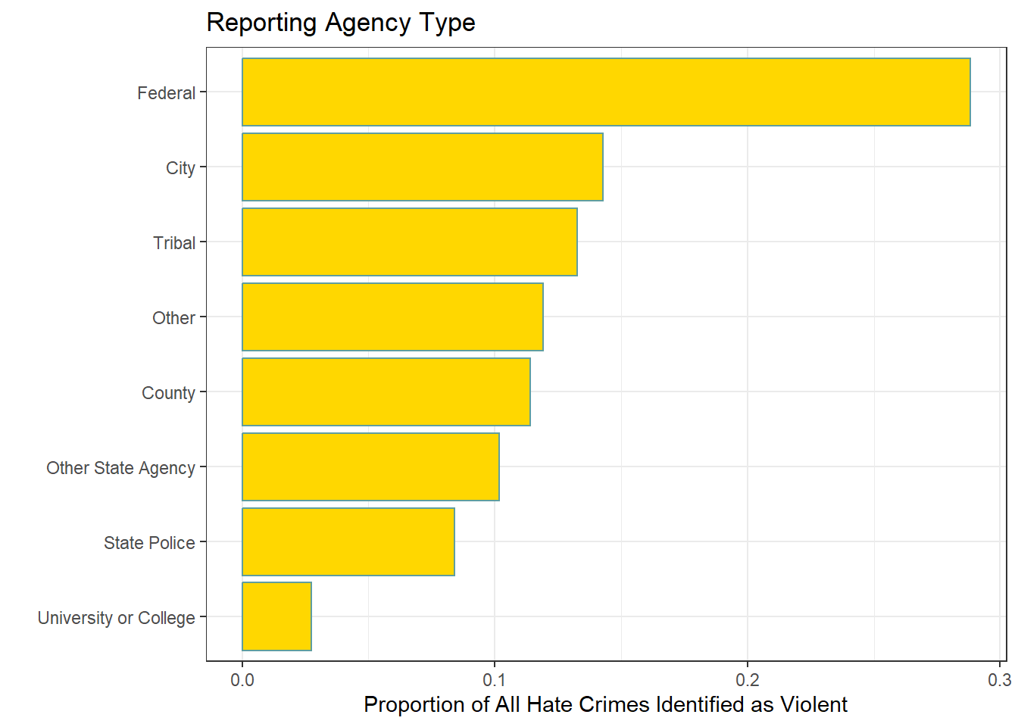
What is the distribution of violent hate crimes by reporting agency?
Federal agencies tend to report violent hate crimes most frequently, followed by city and tribal authorities.

Slide 17
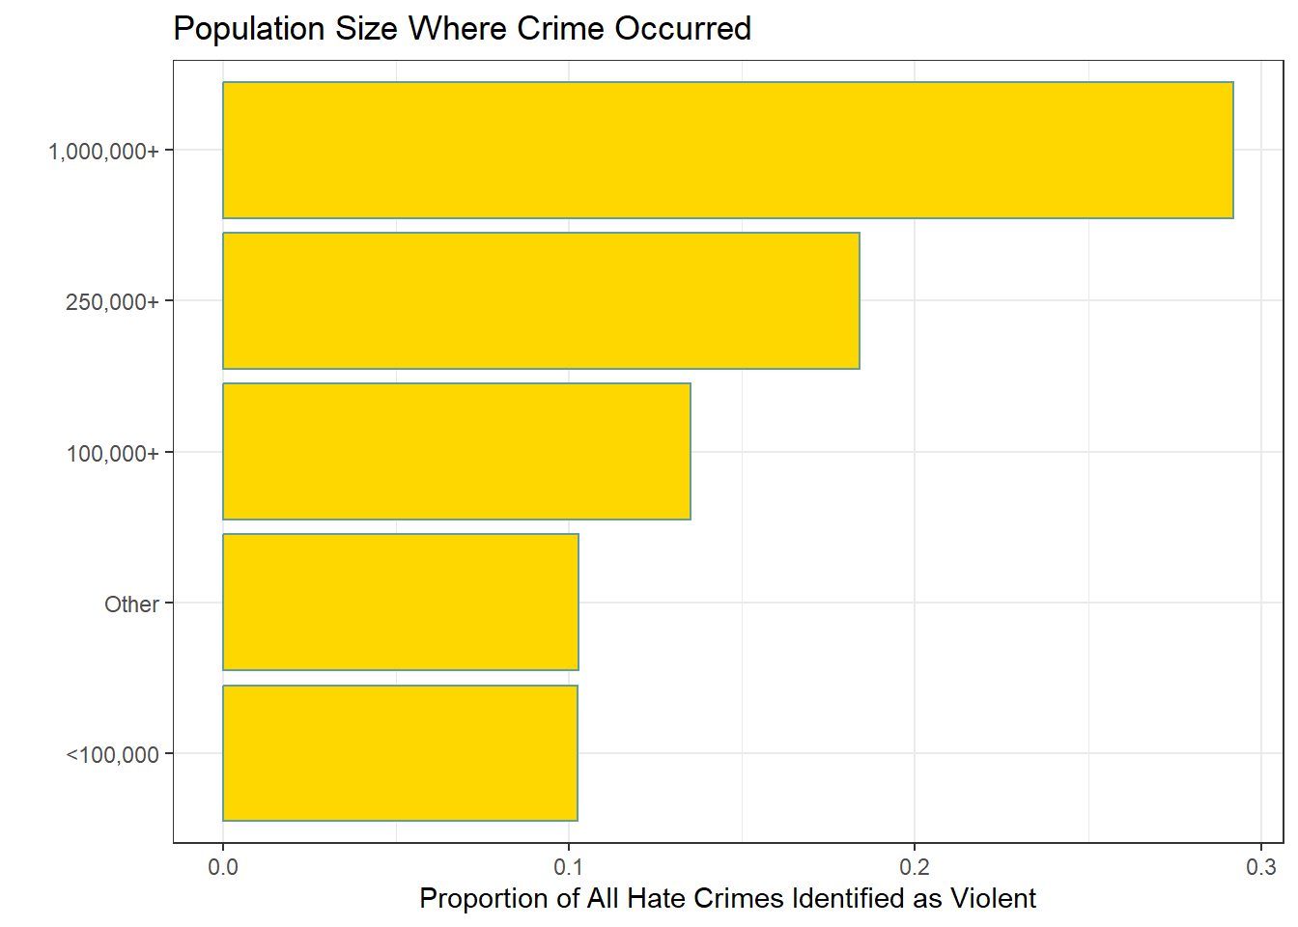
What is the distribution of violent hate crimes relative to the population size where the crime occurred?
Urban population centers in the United States exhibit a higher proportion of violent hate crimes, particularly in cities with populations exceeding 1 million.

Slide 18
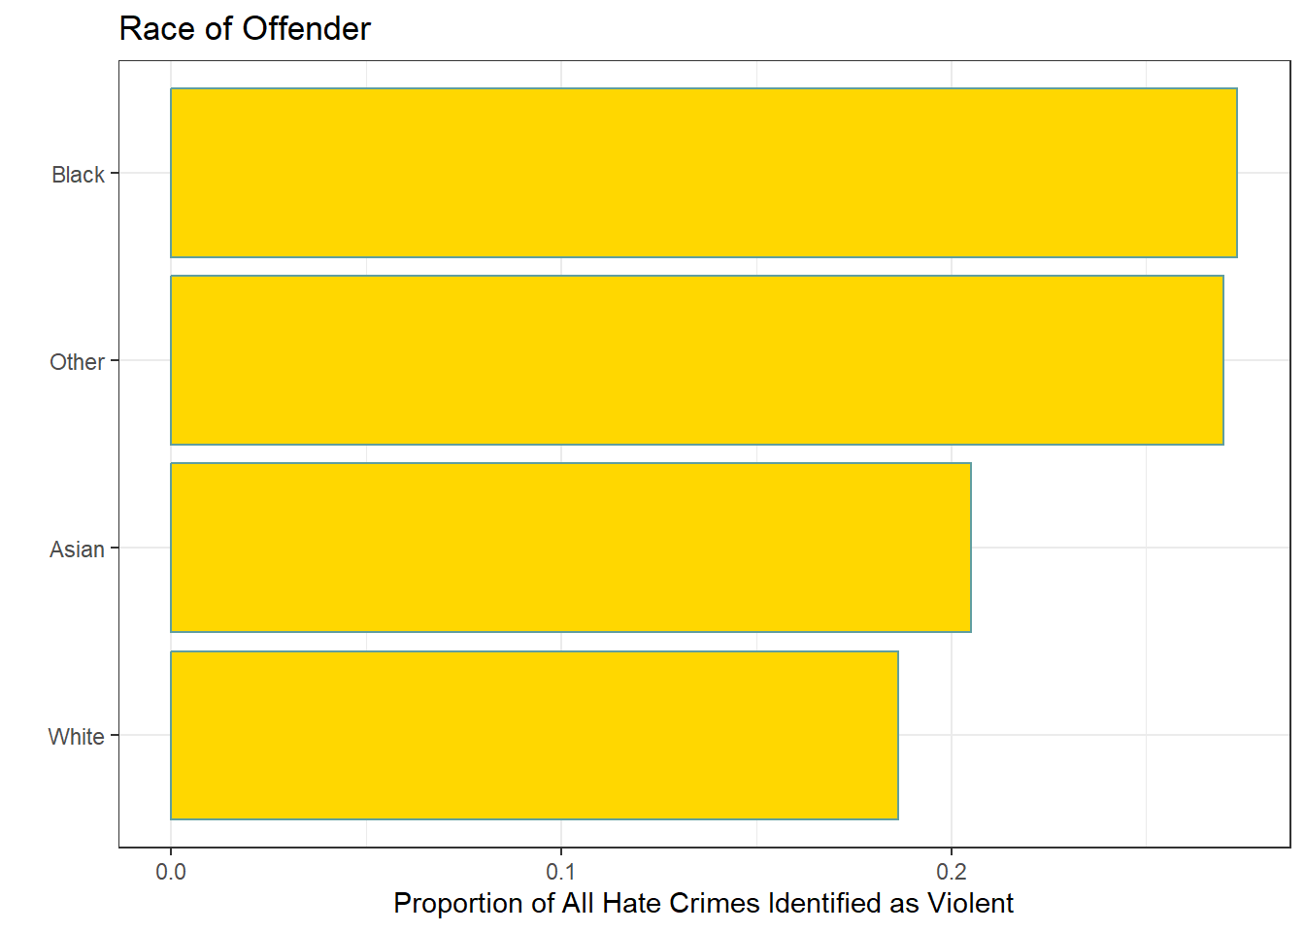
Race of Offender
One of the features related to offenders in the dataset that warrants exploration is the race of the perpetrator. Notably, there was an approximate 9% disparity in violent crimes between Black and White offenders.

Slide 19
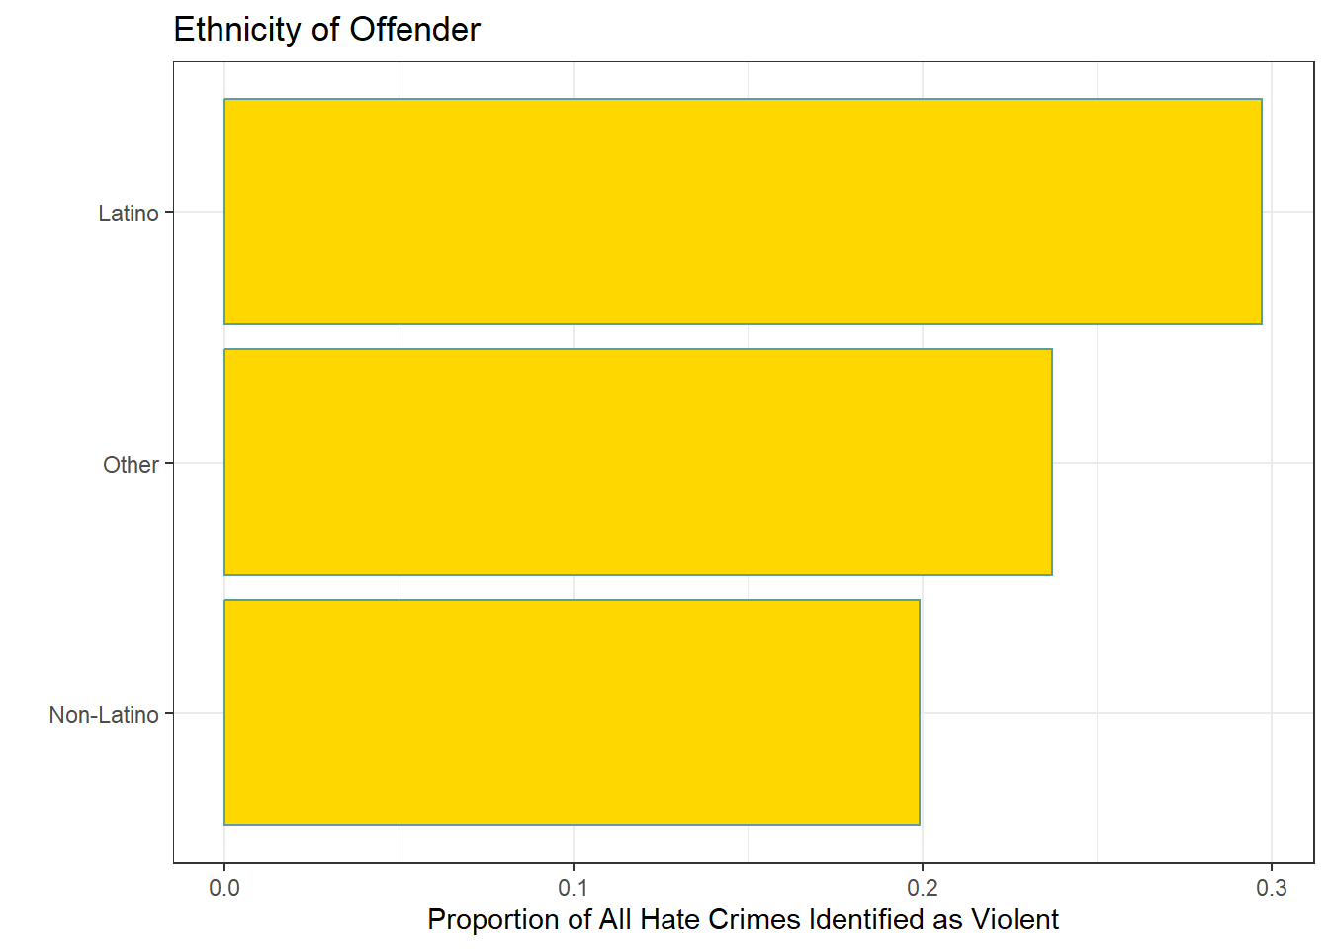
Ethnicity of Offender
Similarly, there was an approximate 10% disparity in violent crimes between Latino and Non-Latino offenders.

Slide 20
Ethnicity of Offender
Similarly, there was an approximate 10% disparity in violent crimes between Latino and Non-Latino offenders.

Slide 21
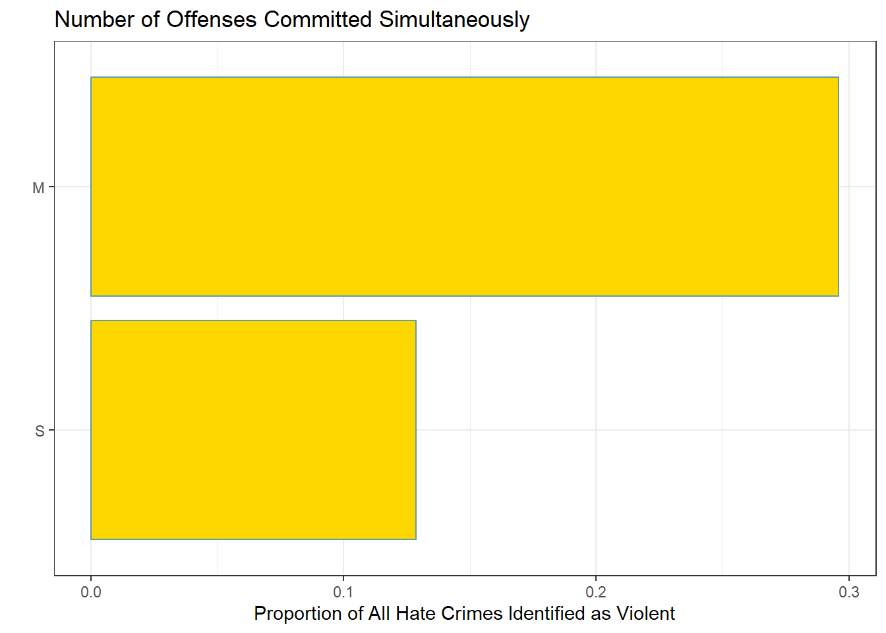
Multiple Offences Simultaneously
Violent hate crimes are more frequently associated with multiple offenses, which can be interpreted as indicating that such crimes are nearly twice as likely to occur in clustered incidents rather than as isolated occurrences.

Slide 22
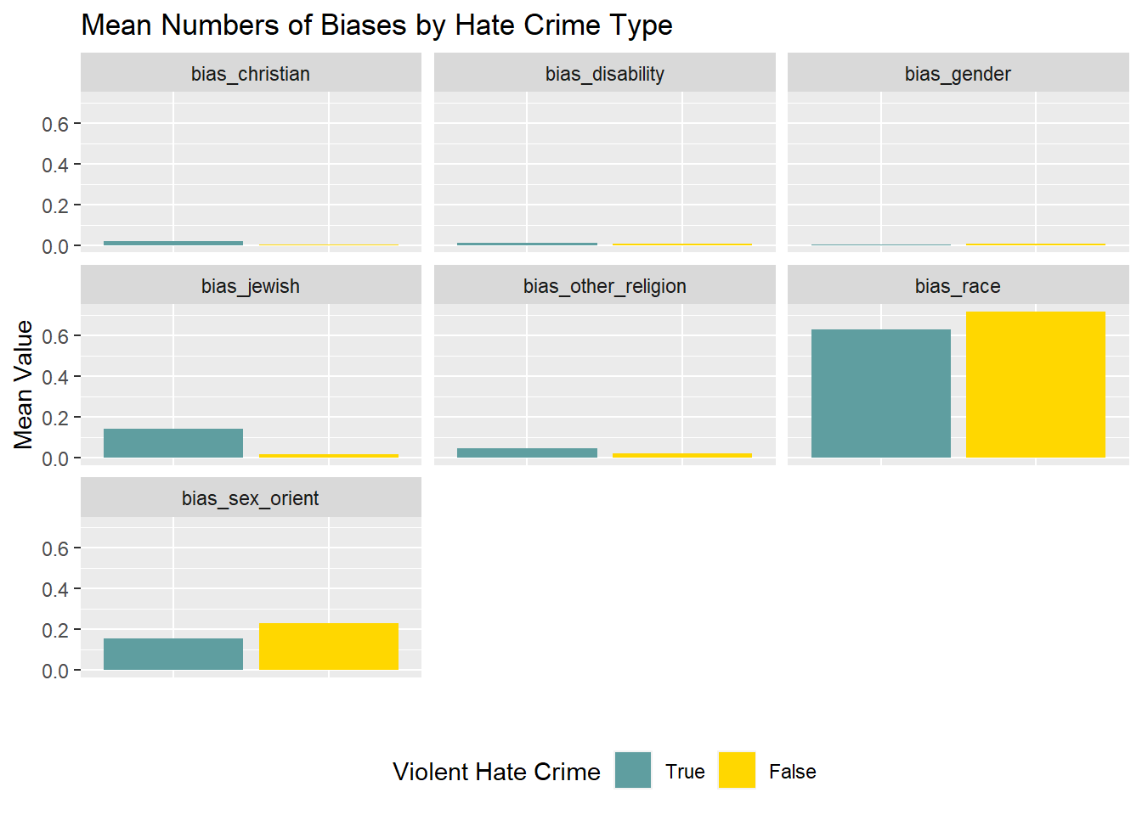
What is the distribution of violent hate crimes by bias description?
Racial bias constitutes the largest proportion of violent hate crimes in the United States, followed by sexual orientation bias.

Slide 23
EXPERIMENTATION AND RESULTS
CORRELATION
Exploratory Data Analysis (EDA)
is crucial for understanding the dataset before building predictive models.
One important aspect of EDA is assessing multicollinearity among predictors.
What Is Multicollinearity?
Multicollinearity occurs when predictors are highly correlated with each other.
It can impact model performance and interpretability.
Impact of Multicollinearity
Overfitting:
Overfitting happens when a model fits training data too closely but performs poorly on test data.
High multicollinearity increases the risk of overfitting.
Reduced Interpretability:
Correlated predictors make it hard to isolate individual effects.
I wanted to understand each predictor’s contribution to the response variable.
Detecting Multicollinearity
Pearson’s Pairwise Correlation Test:
Measures linear correlation between predictors.
No strict threshold, but high absolute values indicate strong correlation.
Findings from the Assessment
Positive Correlations:
Aggravated Assault and Robbery are highly positively correlated with Violent Hate Crime.
Negative Correlations:
Intimidation and Vandalism show the lowest negative correlation with Violent Hate Crime.
Overall Correlation:
Despite specific correlations, overall correlation among predictors is low.

Slide 24
EXPERIMENTATION AND RESULTS
Implications for Modeling
Model Selection:
Consider excluding highly correlated predictors.
Feature Engineering:
Transform or combine features to enhance model performance.
Regularization Techniques:
Use methods like ridge regression or lasso regression to mitigate multicollinearity.
Conclusion
While multicollinearity exists, it’s not a high concern due to low overall correlation.
As data scientists, let’s build robust models that strike the right balance between complexity and interpretability.

Slide 25
LOGISTIC REGRESSION
Introduction
Logistic regression analysis with cross-validation (CV) initially failed to converge.
Multicollinearity wasn’t a primary concern, but the model still struggled.
The issue: too many predictors relative to the number of observations or zero variance features.
Identifying the Culprit
Predictor-Response Mismatch:
With 241,663 observations and only 34 predictors, zero variance features seemed more likely.
These features don’t vary across observations and provide no useful information.
Leveraging nearZeroVar() Function:
Part of Linear Discriminant Analysis (LDA) in R.
LDA is like Principal Component Analysis (PCA) but focuses on outcome variables.
LDA aids in feature reduction when the feature count is too high for meaningful machine learning analysis.

Slide 26
Data Partitioning
To assess model accuracy, I split the dataset into two subsets: training set and testing set.
The split ratio used was 75:25, where 75% of the data was allocated to the training set, and the remaining 25% formed the testing set

Slide 27
Training the Model
The initial step in machine learning involved training a model on a larger dataset. In this case, a full logistic regression model was fitted to the training dataset using the glm() function in R, with the response being whether a hate crime was designated as violent. Previous attempts encountered convergence issues and overfitting, which were resolved through proper encoding and feature reduction using Linear Discriminant Analysis (LDA). However, the most effective way to prevent overfitting is through k-fold cross-validation (CV) of the model.
Ten-fold CV was employed to prevent overfitting of the logistic regression model. By subdividing the training dataset into k-folds, each independently tested for accuracy, I assessed overall performance. After 10-fold CV, accuracy reached 88.8%, but Cohen’s Kappa was only fair at 41%. This suggest potential issues such as multicollinearity or other model-related issues.
Given these results, I decided to use alternative machine learning classifier algorithms beyond logistic regression. While logistic regression assumptions include a binary dependent variable, independent observations, no multicollinearity among predictors, linearity, and sufficient sample size, the reliability of the current model remained uncertain.

Slide 28
Random Forest
Random Forest, an ensemble learning classifier based on binary decision trees, I chose for its ability to handle both continuous and categorical variables. Its complexity makes it robust against collinearity and overfitting. Out-of-box (OOB) performance makes it beginner-friendly, while skilled users can fine-tune hyperparameters.
An OOB Random Forest was trained on the violent versus non-violent classifier using 200 trees. The OOB model had 10.45% total error, but class-specific error rates differed significantly. Non-violent errors decreased to 2.9%, while violent errors remained high at 59%, likely due to class imbalance.
Testing against a separate dataset revealed surprising results: total accuracy was 81%, sensitivity 73%, and specificity 82%. The model struggled to predict both classes, especially violent ones. Low positive predictive value (39%) and significant McNemar’s Test differences highlight the need for further exploration.

Slide 29
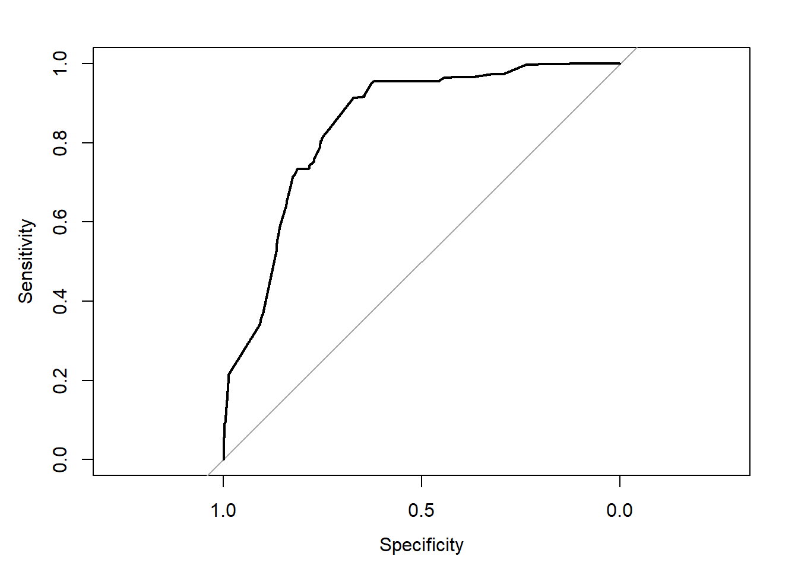
Receiver Operating Characteristic (ROC) curve
Receiver Operating Characteristic (ROC) curve
provides insights into the performance of a binary classification model, particularly in terms of its ability to discriminate between positive and negative classes
Accuracy and Kappa:
The overall accuracy of the model is 81.43%.
Kappa (a measure of agreement beyond chance) is 0.3829, indicating moderate agreement.
Sensitivity and Specificity:
Sensitivity (True Positive Rate or Recall) is 65.68%.
Specificity (True Negative Rate) is 83.87%.
These metrics reflect the model’s ability to correctly identify violent and non-violent instances.
Positive Predictive Value (PPV):
PPV (also known as precision) is 38.73%.
It represents the proportion of correctly predicted violent cases among all predicted violent cases.
Balanced Accuracy:
The balanced accuracy (average of sensitivity and specificity) is 74.78%.
It accounts for class imbalance and provides a more reliable assessment.
McNemar’s Test:
The significant Mcnemar’s Test suggests that the model’s error rates differ significantly between classes.
Model Performance on Violent Class:
The model struggles to predict the violent class (low PPV and sensitivity).
This could be due to the large discrepancy in the proportion of violent versus non-violent instances in the dataset.
Summary:
while the model shows decent overall accuracy, it needs improvement in predicting violent cases. Consider addressing class imbalance or exploring alternative classifiers to enhance performance.

Slide 30
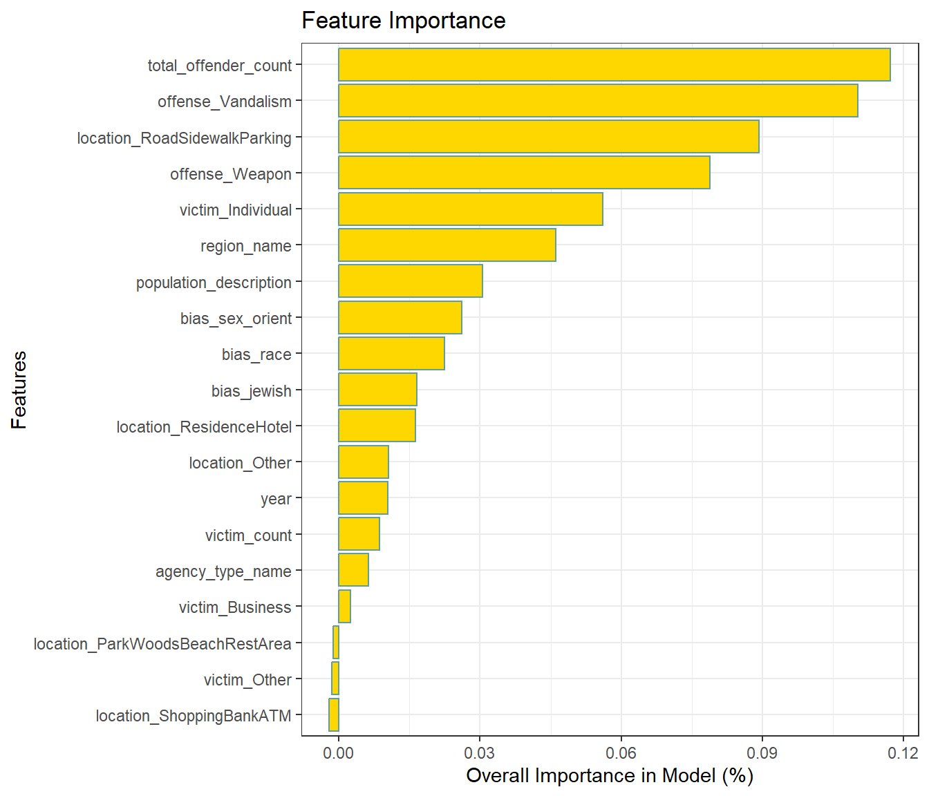
Feature Importance
Receiver-Operator Curve (ROC):
Figure 11 displays the intermediate accuracy of the model.
While the model isn’t performing poorly, it hasn’t reached a deployment-ready level yet.
Feature Importance in Random Forest:
Figure 12 highlights feature importance.
The number of total offenders has the highest importance (albeit very low at 0.12%), followed by other relevant factors related to violent hate crimes.

Slide 31
Conclusion
The Out-of-Bag (OOB) random forest model was robust enough for training. While the OOB model demonstrated intermediate accuracy, there were differences in performance between classifiers. The severe skew in the proportion of violent hate crimes (13.4% out of total hate crimes) posed challenges for any classification algorithm to accurately identify instances of violent hate crime. Despite employing two types of encoding (one-hot for variables with multiple observations and frequency encoding for other categorical variables), noise in the dataset hindered optimal differentiation.
From this model and data exploration, I can identify features of interest worth monitoring. For instance, police and hate crime monitoring agencies could focus on violent crimes involving multiple offenders and weapons near roadsides, sidewalks, or parking lots to investigate potential hate-based motives.
Overall, relative confidence in these conclusions arises from meticulous data cleaning, addressing initial overfitting, and using an appropriate classification algorithm. Future steps involve tuning the random forest model and exploring other classifiers, such as neural networks known for handling noisy datasets.

